Slide 1
Challenge and Opportunities towards Exascale Computing
Thomas Sterling
Arnaud & Edwards Professor, Department of Computer Science
Adjunct Faculty, Department of Electrical and Computer Engineering
Louisiana State University
Distinguished Visiting Scientist, Oak Ridge National Laboratory
CSRI Fellow, Sandia National Laboratory
October 30, 2010

Slide 2
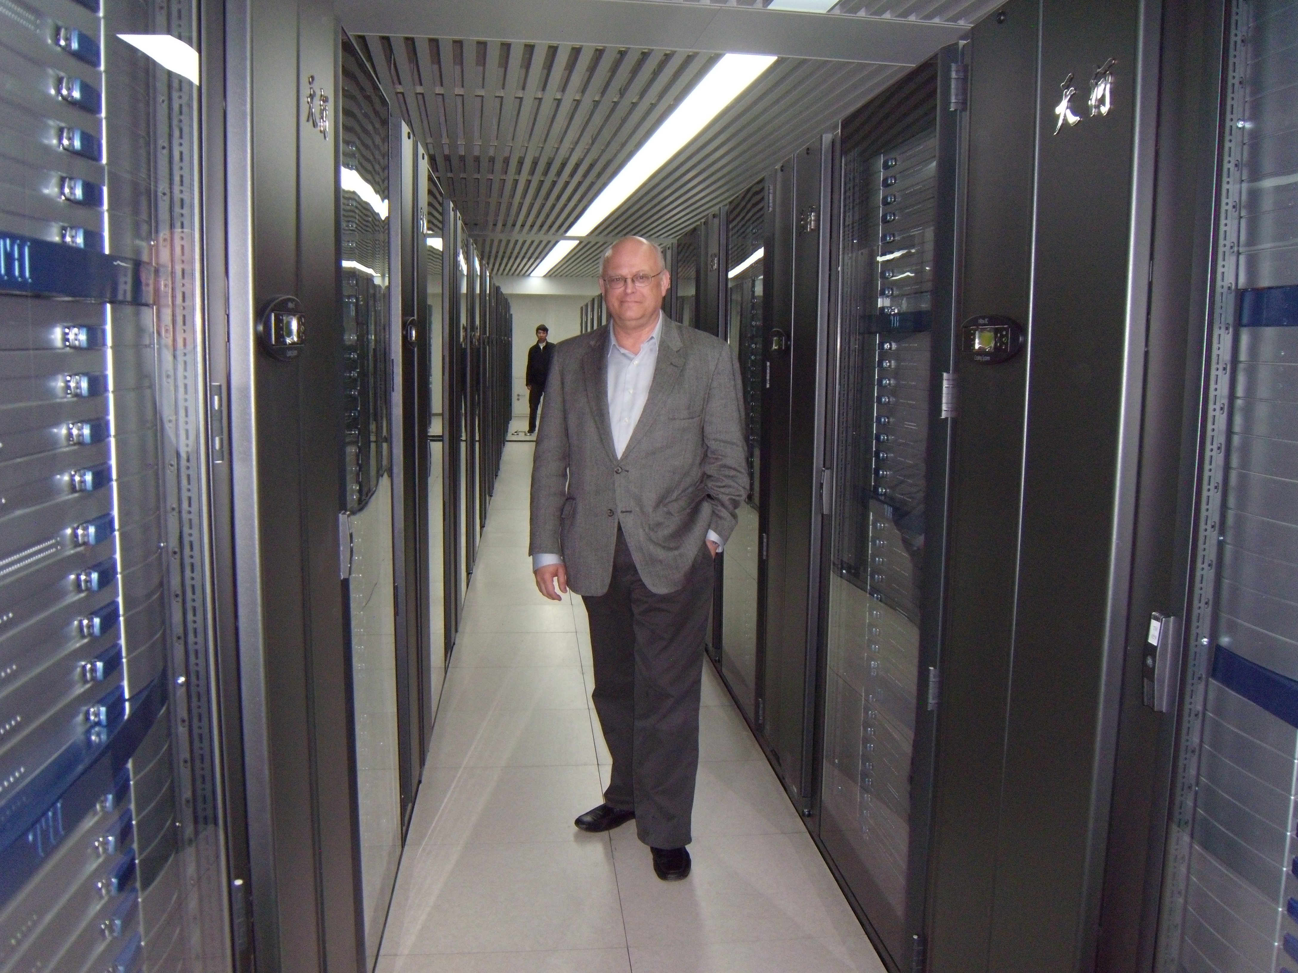
Fastest Computer in the World?

Slide 3
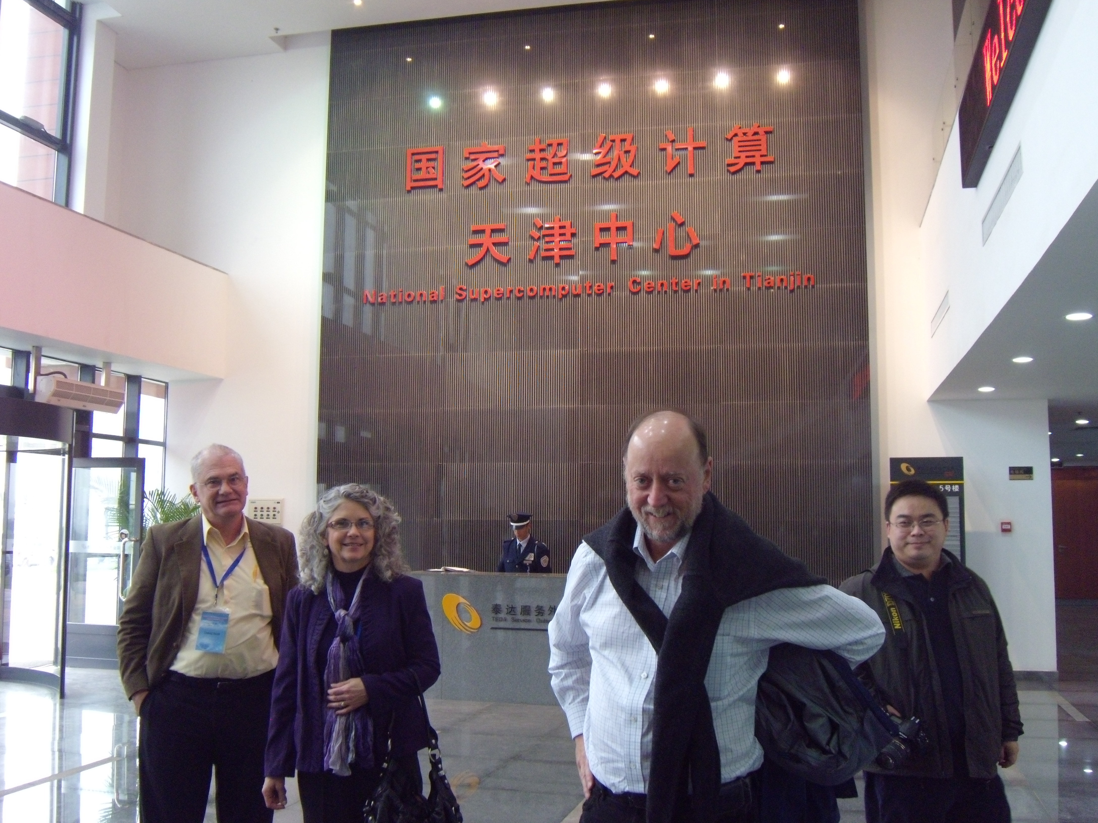
Jack in China

Slide 4


Slide 5
StarSs: … taskified …
#pragma css task input(A, B) output(C)
void vadd3 (float A[BS], float B[BS],
float C[BS]);
#pragma css task input(sum, A) inout(B)
void scale_add (float sum, float A[BS],
float B[BS]);
#pragma css task input(A) inout(sum)
void accum (float A[BS], float *sum);
Compute dependences @ task instantiation time
for (i=0; i<N; i+=BS) // C=A+B
vadd3 ( &A[i], &B[i], &C[i]);
...
for (i=0; i<N; i+=BS) // sum(C[i])
accum (&C[i], &sum);
...
for (i=0; i<N; i+=BS) // B=sum*A
scale_add (sum, &E[i], &B[i]);
...
for (i=0; i<N; i+=BS) // A=C+D
vadd3 (&C[i], &D[i], &A[i]);
...
for (i=0; i<N; i+=BS) // E=G+F
vadd3 (&G[i], &F[i], &E[i]);
1
2
3
4
5
6
7
8
9
10
11
12
13
14
15
16
17
18
19
20
Color/number: order of task instantiation
Some antidependences covered by flow dependences not drawn
Courtesy of Jesus Labarta, BSC

Slide 6
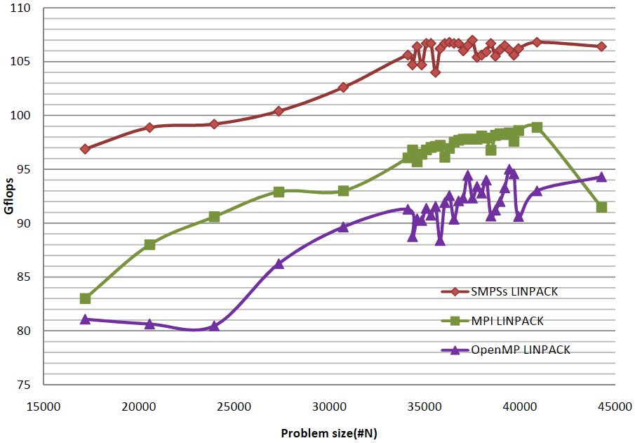
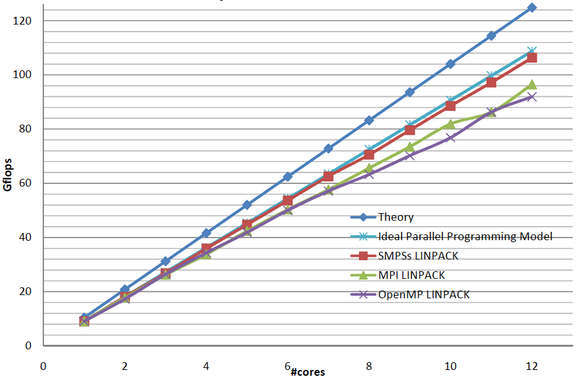
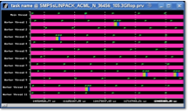

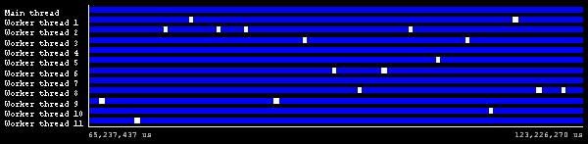
StarSs for SMP and multicores
HPL Linpack: Comparison of SMPSs, OpenMP and MPI on a dual socket Istambul
Courtesy of Jesus Labarta, BSC
Notes:
6

Slide 7
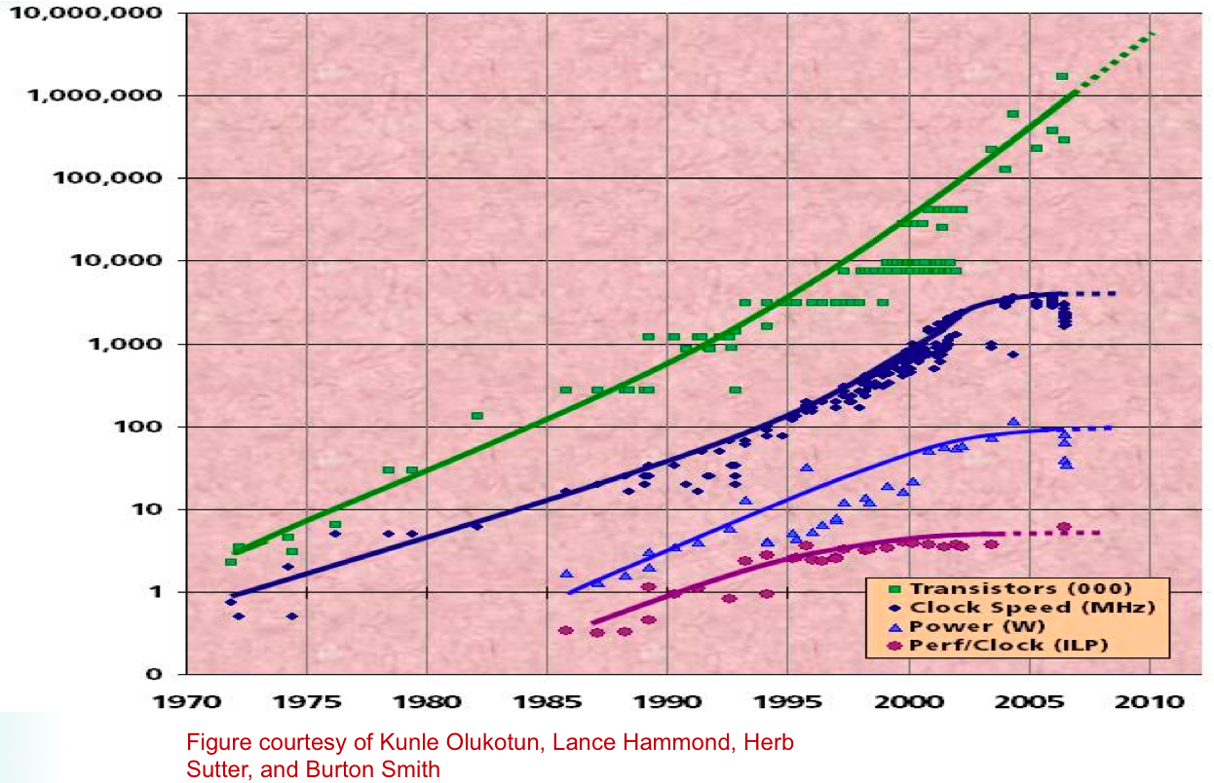
Dramatic Change in Technology Trends

Slide 8
DARPA Exascale Technology Study
Exascale
Lightweight
Heavyweight
But not at 20 MW!
Courtesy of Peter Kogge, UND

Slide 9
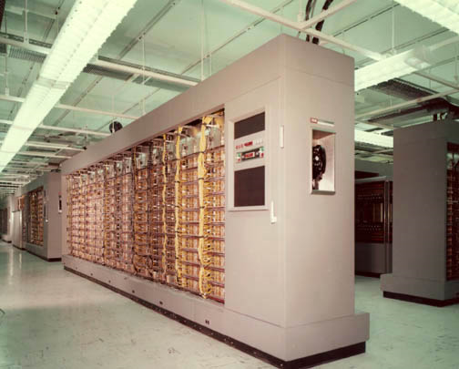
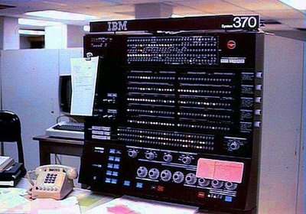



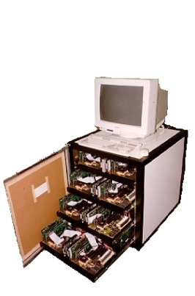
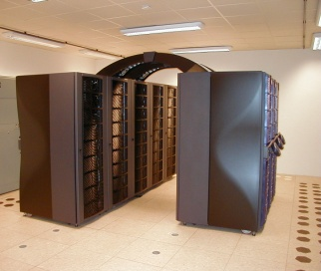
HPC in Phase Change
  Phase I: Sequential instruction execution (1950)
  Phase II: Sequential instruction issue (1965)
    pipeline execution,
    reservation stations,
    ILP
  Phase III: Vector (1975)
    pipelined arithmetic, registers, memory access
    Cray
  Phase IV: SIMD (1985)
    MasPar, CM-2
  Phase V: Communicating Sequential Processes (1990)
    MPP, clusters
    MPI, PVM

Slide 10
Game Changer – Runtime System
Runtime system
  is: ephemeral, dedicated to and exists only with an application
  is not: the OS, persistent and dedicated to the hardware system
Moves us from static to dynamic operational regime
  Exploits situational awareness for causality-driven adaptation
  Guided-missile with continuous course correction rather than a fired projectile with fixed-trajectory
Based on foundational assumption
  More computational work will yield reduced time and lower power
  Untapped system resources to be harvested
  Opportunities for enhanced efficiencies discovered only in flight
  New methods of control to deliver superior scalability
“Undiscovered Country” – adding a dimension of systematics
  Adding a new component to the system stack
  Path-finding through the new trade-off space

Slide 11
Runtime Solutions - Opportunities
Adaptive scheduling
  Load balancing
  Contention avoidance, hot spots
Lightweight mechanisms
  Reduced overhead
Finer granularity user threads
  Increased concurrency for greater scalability
Expanded synchronization semantics
  Eliminate barriers, more intelligent control
Runtime exploitation of Compile time programmer knowledge
  Dedicated to specific application
Adjusting to physical realities
  Fault tolerance
  Power management

Slide 12
Everything Changes
Programming Model
  Must exploit runtime decision making
  Must inform on policy choices and aggregate behavior
Compilers
  Close interface to drive runtime system
  Provide known factors for decision making
    Pass through user provided information
    Provide compiler derived information
Operating System
  Close interface to support runtime system
  Provide system resources and negotiate
  Support protection against hardware and software faults and malicious attack
Architecture
  Provide adequate parallel capability and capacity
  Low overhead critical path mechanisms for efficiency and scalability
  Hardware support for address protection and I/O security

Slide 13

The Execution Model Imperative
HPC in 6th Phase Change
  Driven by technology opportunities and challenges
  Historically, catalyzed by paradigm shift
Guiding principles for governing system design and operation
  Semantics, Mechanisms, Policies, Parameters, Metrics
Enables holistic reasoning about concepts and tradeoffs
  Serves for Exascale the role of von Neumann architecture for sequential
Essential for co-design of all system layers
  Architecture, runtime and operating system, programming models
  Reduces design complexity from O(N²) to O(N)
Empowers discrimination, commonality, portability
  Establishes a phylum of UHPC class systems
Decision chain
  For reasoning towards optimization of design and operation

Slide 14

Decision Chain
Axiom: an operation is performed at a certain place at a certain time to achieve a specified effect
How did this happen?
Every layer of the system contributed to the time/space/function event – the decision chain
A program execution comprises the ensemble of such events across the system space and throughout the execution epoch
There are many such paths that lead to a final result
But not all minimize time and energy
Understanding of the decision chain required for optimization
Execution model required for understanding the decision chain

Slide 15













X-Caliber – Exascale Capability
Richard Murphy, Jim Ang, Ron Brightwell, Peter Kogge, Scott Hemmert, Bob Lucas, Kunle Olukotun, Marc Snir, Thomas Sterling, David Bayliss, Jeff Draper, Gary Bernstein, Jacque Chame, Pedro Diniz, Bill Gropp, Vince Freeh, Bruce Jacob, Tony Lentine, Supratik Mukhopadhyay, Ram Ramnujam, Dave Resnick, Arun Rodrigues, Subhash Shinde, Sudha Yalamanchili
Team Formed 2 Years Ago

Slide 16
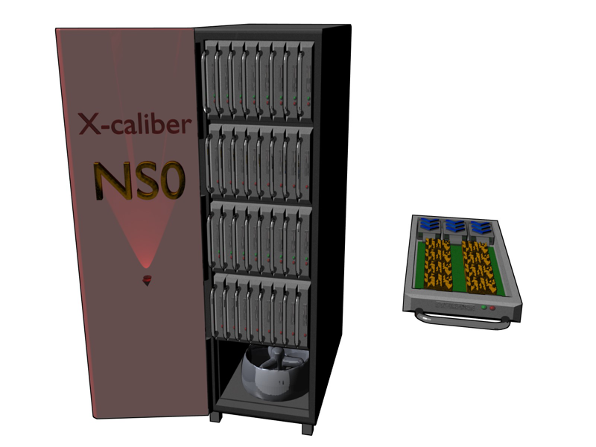
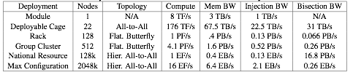
X-caliber System
Rack Scale
  Processing:128 Nodes, 1 (+) PF/s
  Memory:
    128 TB DRAM
    0.4 PB/s Aggregate Bandwidth
  NV Memory
    1 PB Phase Change Memory (addressable)
    Additional 128 for Redundancy/RAID
  Network
    0.13 PB/sec Injection, 0.06 PB/s Bisection

Slide 17
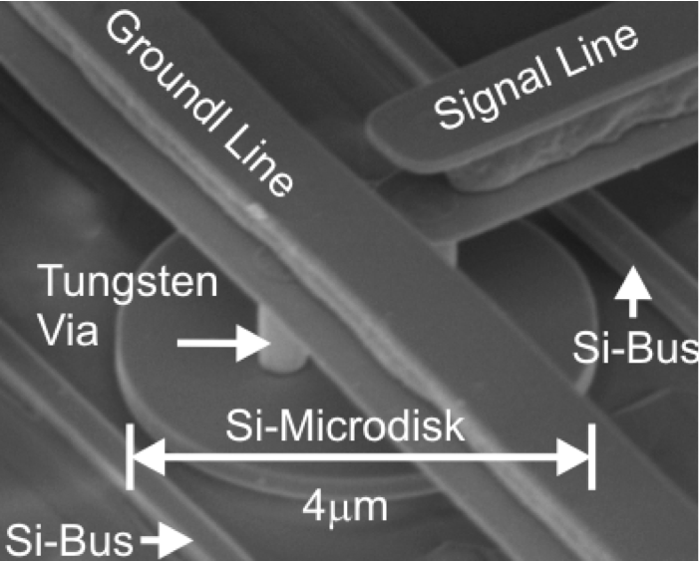
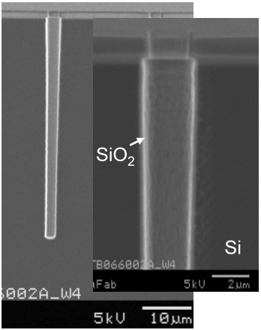
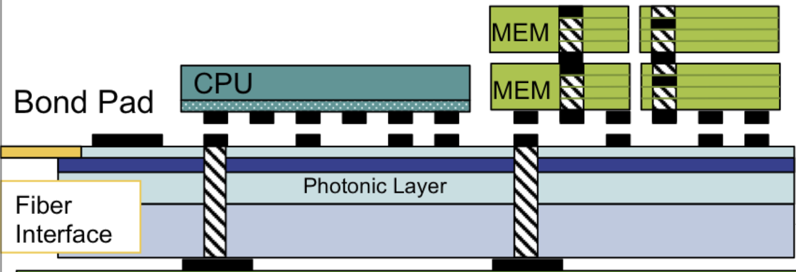
Our Enabling Technologies: Advanced Packaging, 3D Integration, Optics
Stacked dies for high bandwidth at low latency. Includes Embedded Memory Processors in memory stacks.

Slide 18
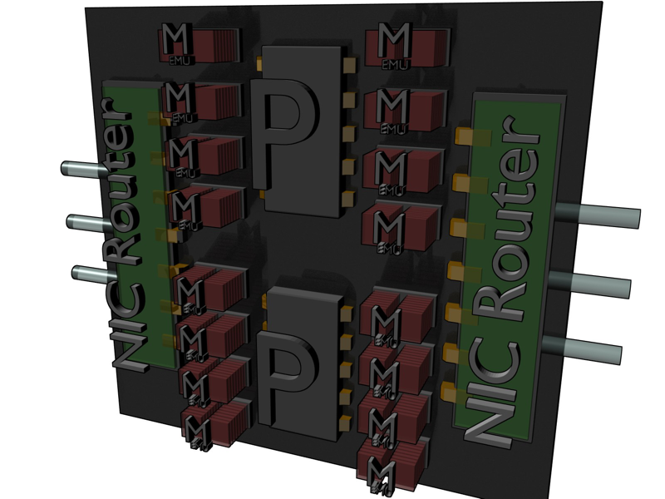
Node Architecture

Slide 19
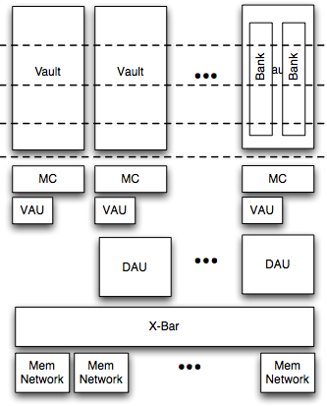
Memory System (M)
Two computation Units
  Right next to the DRAM vault memory controller (VAU)
  To aggregate between DRAM vaults (DAU)
“Memory Network” Centric
Homenode for all addresses
  Owns the “address”
  Owns the “data”
  Owns the “state” of the data
  Can build “coherency”-like protocols via local operations
  Can support PGAS-like operations
  Can manage thread state locally

Slide 20
A Next-Gen Parallel Execution Model
Goals:
  Guide Exascale system co-design for hardware, software, and programming
  Dramatic gains in scalability, efficiency, and programmability
  Framework for reliability, power management, security
  Empower dynamic knowledge management and other graph-based problems
Strategy:
  Move work to data when appropriate; not always data to work
  Dynamic adaptive resource and task management
  work-queue split-phase transaction execution model for high utilization
  Hierarchy name space for ease of data access with capabilities addressing for security
Constituent Components
  Hierarchical Active Global Address Space, AGAS
  Parallel processes spanning and overlapping multiple nodes
  Parcels support message-driven computation and continuation migration
  Local computation complexes (threads) with partial dataflow operations on private data
  Local Control Objects, LCO, for lightweight synchronization and global parallel control state; includes dataflow and futures control
  Percolation for efficient use of heterogeneous resources

Slide 21
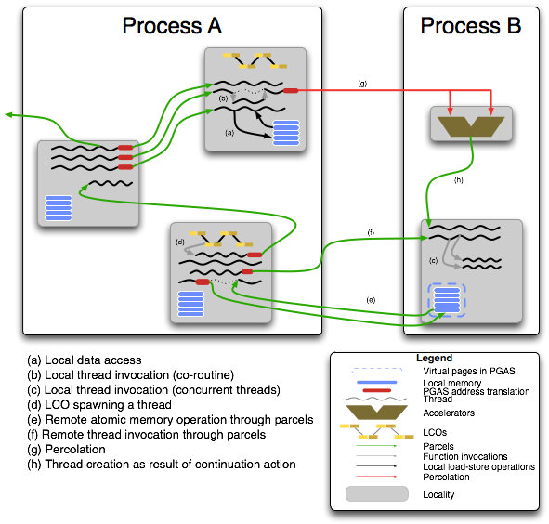
PX Model Components
Notes:
This diagram illustrates many of the key semantic constructs and mechanisms of the ParalleX (PX) model of computation. The shaded squares represent physical localities. All operations within a locality are synchronous. All operations between localities are asynchronous. A process is a context that defines data and tasks to be performed on the localities to which it is assigned. A process may be allocated multiple localities; these not be in any way mutually local to each other. More than one process can share a locality (not shown). Process A is allocated three localities while Process B is on one locality but also uses a separate physical execution unit. Processes can incorporate child processes (not shown). Processes are illustrated by large rectangular transparent boxes.
Basic tasks in the ParalleX model are conducted by “threads” which are partially ordered instructions working on a potentially infinite set of registers. This convenient abstraction minimizes the number of anti-dependencies to permit easy back end compilation to diverse ISA and data paths for different cores. In the diagram, the threads are represented by black worm-like “squiggly” lines. While a process may span multiple localities, a thread by definition resides on only one locality at a time and usually (but not necessarily) on a single locality throughout its lifetime. Threads are ephemeral: each is created at some point in time, performs its work, and terminates. A thread may be suspended but the ideal thread is relatively lightweight, works only on local data and terminates quickly. The effect of a thread may be manifest in several ways: 1) it changes local mutable state, 2) it creates sibling threads (or processes) that outlive it, or 3) it creates parcels that invoke remote threads (or processes) or change remote mutable state. Threads are first-class objects with names in the same name space as variables and objects. They can be manipulated by other threads potentially of other processes. Threads can be suspended to form objects called “depleted threads”. A depleted thread contains all the private state of an active thread but takes up no physical execution resources other than a little main memory space. A depleted thread is a first class object and has the same virtual address of the original thread from which it is derived. Therefore, it can be accessed; its state modified; and, it can cause a new thread with the original name to be created (equivalent to reactivating the old thread). Threads perform almost all the work of the program. The exception is the parcel that directly effects remote state without invoking a thread.
Parcels are a class of active messages. They are illustrated by the green lines that connect between localities. Parcels support semantics at remote localities that threads can perform directly within their resident locality. These are creating remote threads or processes, changing remote state through compound atomic operations, or manipulating threads or processes directly. A parcel carries four types of information: a) the name (virtual address) of the object upon which it is to operate, b) the action to be performed, c) a set of operand values, and d) a continuation specifying what is to happen upon completion of the specified action. The actions can be thread invocations, process instantiations, or primitive compound atomic operations on virtual data or physical devices with physical addresses. Parcels support asynchronous operation of the ParalleX environment. Parcels can arrive at any time and order of arrival is not guaranteed. They can be relatively short with little or no operand values, or be very long when used to move blocks of data. Parcels are not first class objects and do not have virtual names. Locally at the source and destination localities parcels do display handles for local manipulation. Parcels belong to a global object called the “parcel set”.
A special form of the parcel is used for a methodology called percolation. Percolation moves the entire work foot print of a thread to a remote physical execution site. It is illustrated by the red lines between thread and functional unit. By foot print it is meant to include the instructions of the thread, the stack frame of the thread, the input arguments used for the thread, and any other information required to fully instantiate the thread on the remote execution site. Percolation is used to make efficient use of relatively precious resources like accelerators, GPUs, FPGAs, or expensive streaming processors. It does so by assuming the overhead and hiding the latencies that such a unit would otherwise have to incur. Thus percolation supports prestaging of execution information. Percolation is also used to dynamically allocate new resources within a system to an application program.
A critical element to the management and coordination of global parallel flow control is the Local Control Object of “LCO” shown as small yellow/brown-green splotches. An LCO is a synchronization object in the object-oriented sense. It has associated with it both state and methods that operate upon the state. LCOs are first-class objects in that they have names that are virtual addresses like other variables. The purpose of the LCO is to coordinate global flow control by means of a number of different types of synchronization mechanisms from simple mutex elements to sophisticated dataflow templates and futures constructs. An LCO is accessed like any other object locally by a thread or remotely by a parcel possibly changing its state. An LCO includes one or more criteria which if satisfied will result in the instantiation of a thread. LCOs can also buffer incoming requests until such a condition can be satisfied. This may include the availability of physical resources. The LCO is the embodiment of a continuation. The continuation field of a parcel with some exceptions is a reference to one or more LCOs.

Slide 22
ParalleX Processes
Provides execution contexts
  Hierarchical (nested)
  Active Global Address Space (AGAS)
Processes with internal parallel execution
  Many activities within a process may operate concurrently
  Threads & child processes
Span multiple CACs
  May overlap CACs
Ephemeral
  Created at any time by parent process
  May terminate at any time
Functional and Object-Oriented Calling Sequence

Slide 23
ParalleX Process Hierarchy
Main
Operands (strict & eager)
SD
SD
Data
Methods Codes
SD
SD
I/O Process
Resource Configuration
Child Processes
CAC
CAC
CAC
CAC

Slide 24
Multi-Grain Dataflow Multithreading:
Computation Complexes (CC)
Threads are collections of related operations that perform on locally shared data
A thread is a continuation combined with a local environment
  Modifies local named data state and temporaries
  Updates intra-thread and inter-thread control state
Does not assume sequential execution
  Other flow control for intra-thread operations possible
Thread can realize transaction phase
Thread does not assume dedicated execution resources
Thread is first class object identified in global name space
Thread is ephemeral

Slide 25
Local Control Objects
A number of forms of synchronization are incorporated into the semantics
Support message-driven remote thread instantiation
Finite State Machines (FSM)
In-memory synchronization
  Control state is in the name space of the machine
  Producer-consumer in memory
  Local mutual exclusion protection
  Synchronization mechanisms as well as state are presumed to be intrinsic to memory
Basic synchronization objects:
  Mutexes
  Semaphores
  Events
  Full-Empty bits
  Data flow
  Futures
  …
User-defined (custom) LCOs

Slide 26
Dataflow LCO
Inherited Generic Methods
Incident input operand values
Operand Value Buffer
Control State
# values
New Thread Create
New Thread
Predicate (all values?)
Event Assimilation Method
Control Method
Thread Method

Slide 27
Motivation for Message-Driven Computation
To achieve high scalability, efficiency, programmability
To enable new models of computation
  e.g., ParalleX
To facilitate conventional models of computation
  e.g., MPI
Hide latency
  Support overlap of communication with computation
  Move work to data, not always data to work
Work-queue model of computing
  Segregate physical resource from abstract task
  Circumvent blocking of resource utilization
Support asynchrony of operation
Maintain symmetry of semantics between synchronous and asynchronous operation

Slide 28
Parcel Structure
Transport / network layer
protocol wrappers
destination
action
payload
continuations
CRC
header
trailer
PX Parcel
Parcels may utilize underlying communication protocol fields to minimize
the message footprint (e.g. destination address, checksum)

Slide 29
Parcel Handler Implementation
Atomic
DMA Ops
Memory
Parcel
Class Buffer
Data Movement Control
Data block store
Data block request
Atomic data operations & L/S
Basic LCO
Thread & OS instantiation
Thread load
Thread management
Hardware
Packet Buffer
from NIC
Thread Create
Thread Manager Interface
Primitives

Slide 30
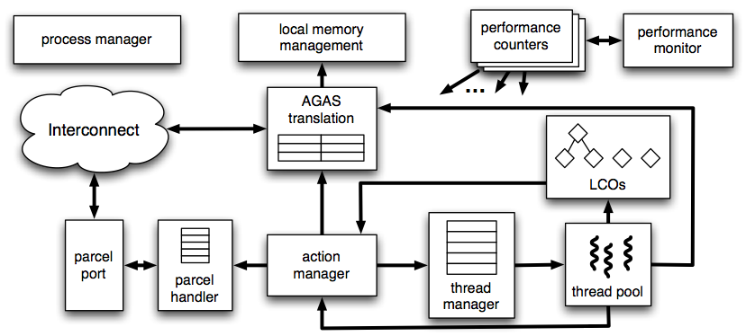
HPX Runtime System

Slide 31
Fibonacci Sequence
Notes:
Using two cores to the previous experiment shows good scaling for the HPX runtime system with response time becoming half of the single core runtime while maintaining the same number of concurrent threads, still far greater than the Java virtual engine or the Pthreads OS implementation.

Slide 32
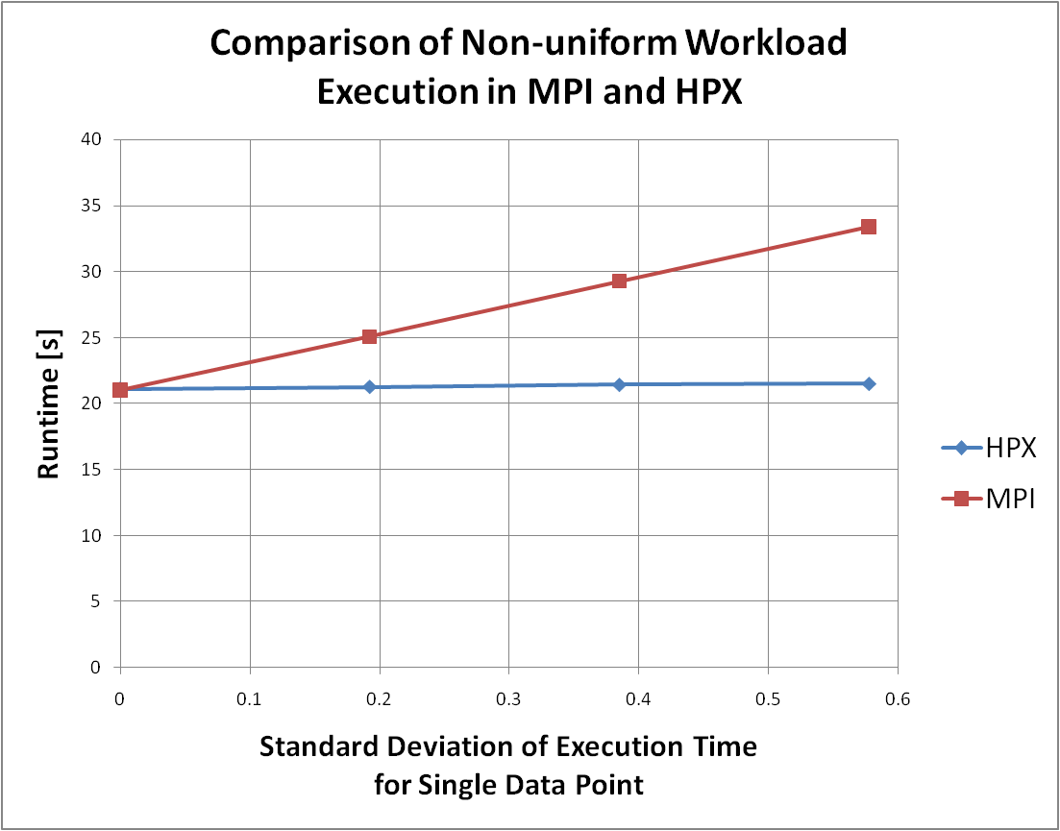
Using HPX for Variable Threads

Slide 33
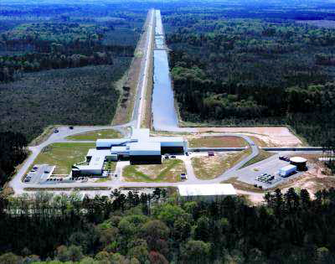
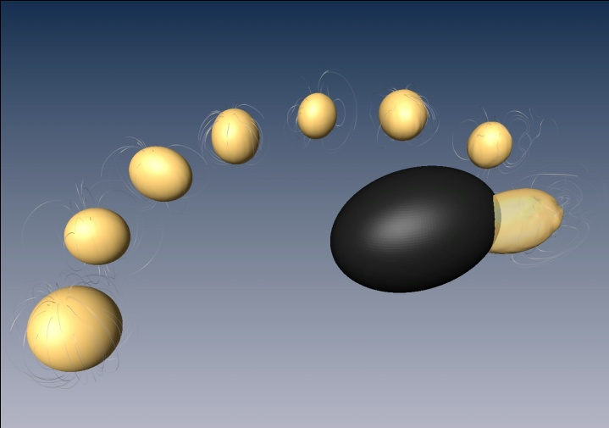
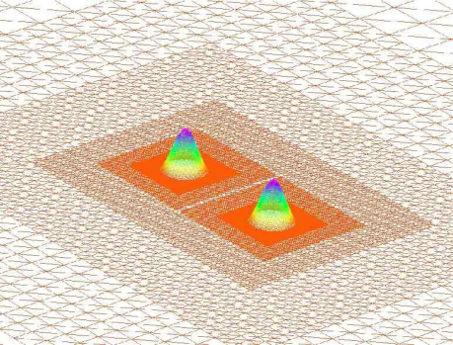
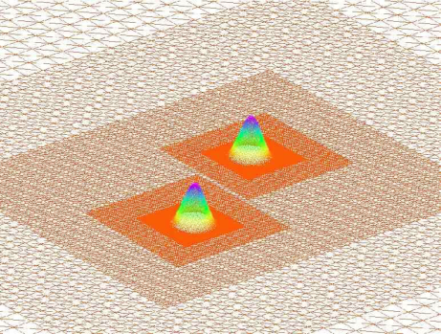
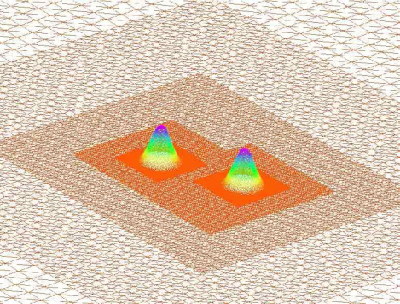
Application: Adaptive Mesh Refinement
(AMR) for Astrophysics simulations
Binary black hole and black hole neutron star mergers are LIGO candidates
AMR simulations of black holes typically scale very poorly

Slide 34
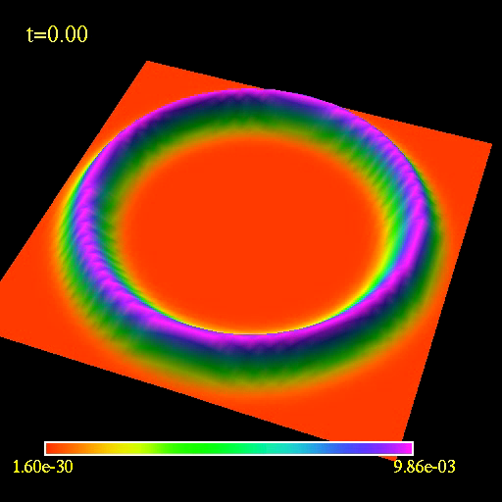
Example: exploring critical collapse using
Parallex based AMR with quad-precision.

Slide 35
Using HPX for AMR
Out_{1,i, i-1}
Out_{1,i, i}
Out_{1,i, i+1}
Stage 1
F_{1, i-1}
F_{1, i}
F_{1, i+1}
…
…
Stage 0
F_{0, i-1}
F_{0, i}
F_{0, i+1}
…
…
In_{0,i, i-1}
In_{0,i, i}
In_{0,i, i+1}
Notes:
A more important test case using ParalleX and the HPX runtime system is one in which

Slide 36
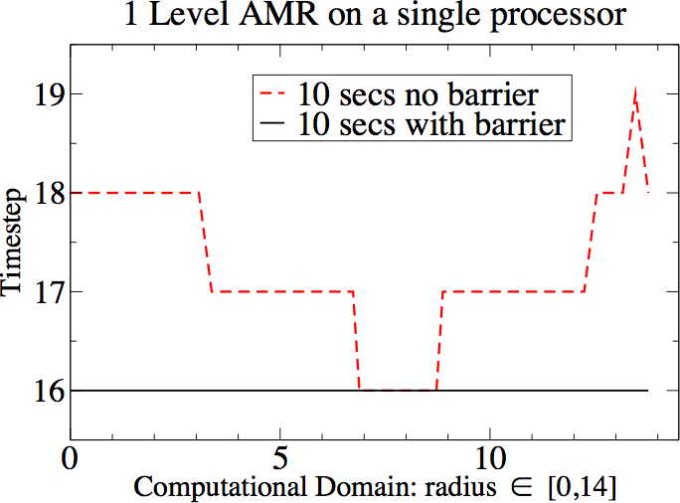

Slide 37
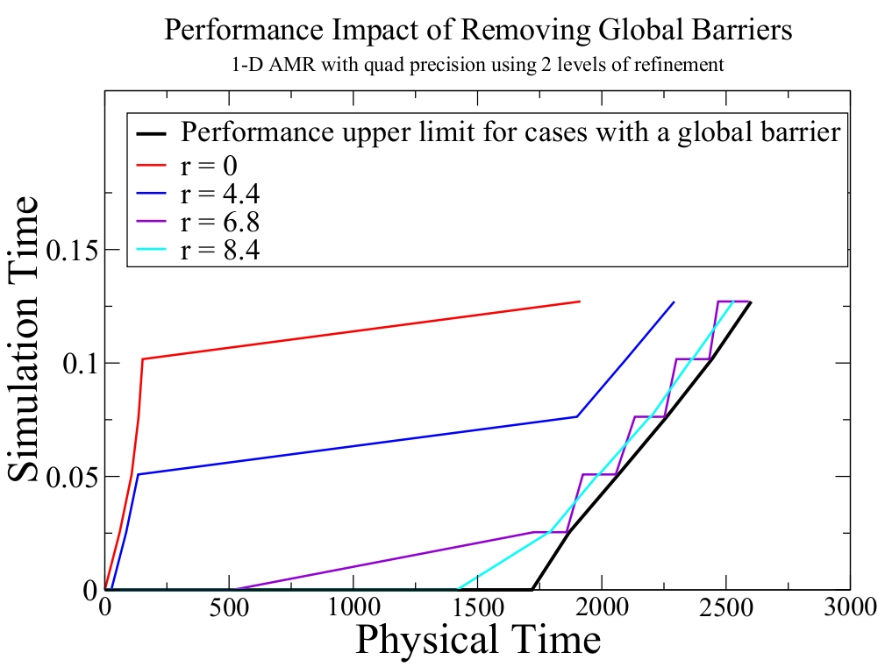
Application: Adaptive Mesh Refinement
(AMR) for Astrophysics simulations
ParalleX based AMR removes all global computation barriers, including the timestep barrier (so not all points have to reach the same timestep in order to proceed computing)

Slide 38
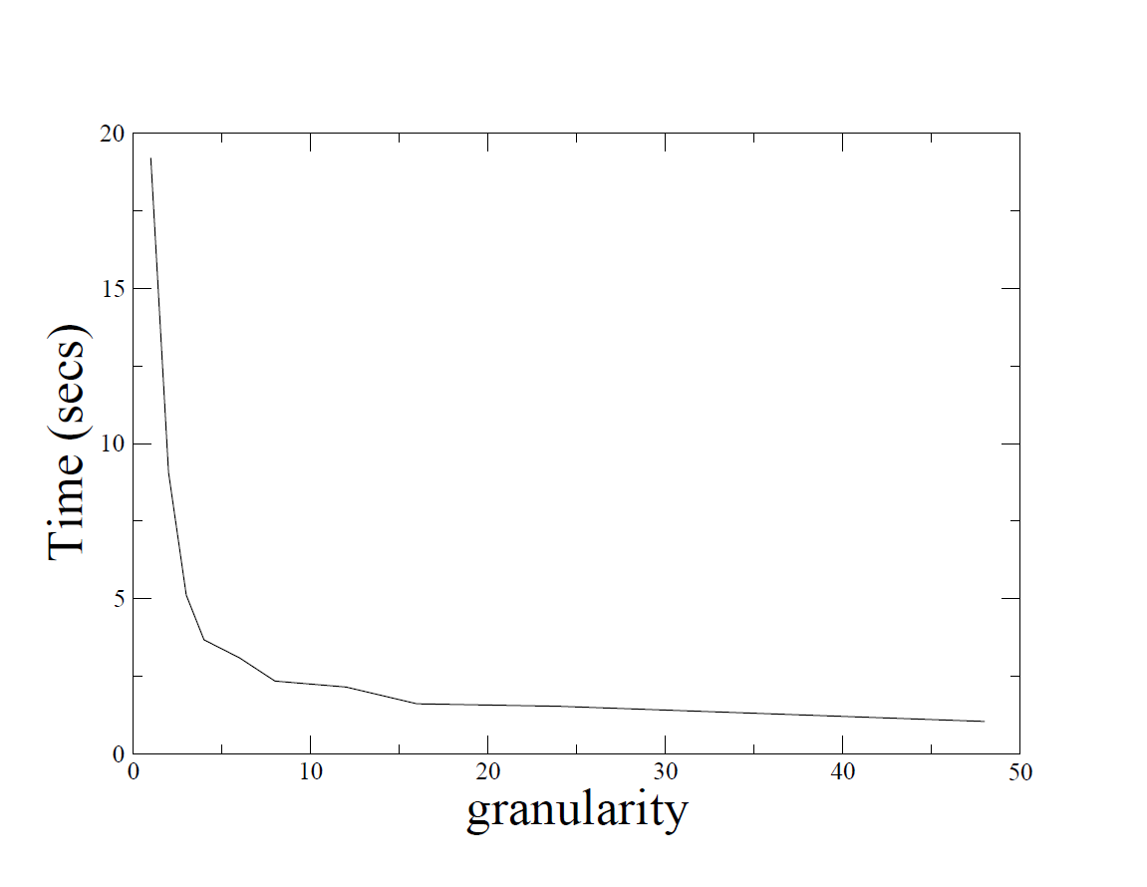
AMR Granularity
Notes:
Here is the plot of execution time versus granularity for the nonlinear wave code. The code was run for 400 steps on a single core.
Granularity: number of data points handled together
The main messages I take from this plot:
when an application code requires very little work per px thread, you may need to slightly increase the granularity (number of points computed per px thread) to get good performance. You generally don't have to increase it much, though, because of the exponential dieoff behavior observed in the plot.
using hpx, it is very easy to control the granularity as a runtime parameter.

Slide 39
Conclusions
The future of HPC demands innovative response to technology challenges and application opportunities
HPC is entering Phase VI requiring a new model of computation
  Attack starvation, latency, overhead, & waiting for contention (SLOW)
  Dynamic adaptive resource management & task scheduling
  Dynamic graph-based applications for knowledge management (AI)
ParalleX represents an experimental step
  Dynamic, overlap/multiphase message-driven execution
Large scale runtime experiments required to guide progress
  Application driven
  Stimulate work in Architecture and Programming Models
  ParalleX provides an experimental model with HPX reference implementation

Slide 40




